Slide 1
Medicare Enrollment Portal
Broker Training
10182021

Slide 2
Module Description
This module is designed to provide an overview of the Medicare Enrollment Portal:
Broker Portal Page 4 - 6
Enrollment Portal Navigation Page 7 - 13
Scope of Appointment Page 14 - 20
Application - Getting Started Page 21 - 27
Send a Quote Page 28 - 30
Enroll a Beneficiary Page 31 - 36

Slide 3
Interactive Table of Contents
Control + Click the box below to automatically link to this section
Broker Portal Overview
Scope of Appointment (SOA)
Application- Getting Started
Send a Quote
Enroll a Beneficiary

Slide 4
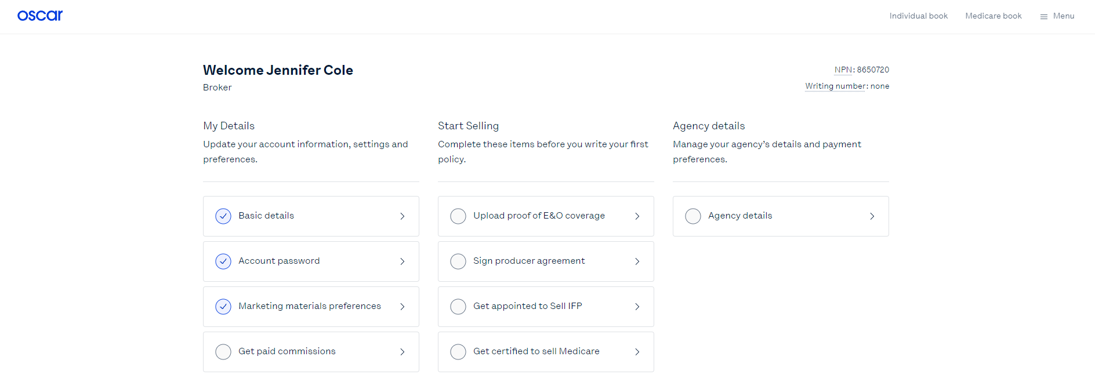
Locating the Medicare Enrollment Portal
After logging into the Broker Portal, locate the Medicare book from the top right corner.
NOTE: The blue checkmark will indicate that section is complete and you are ready to sell.

Slide 5
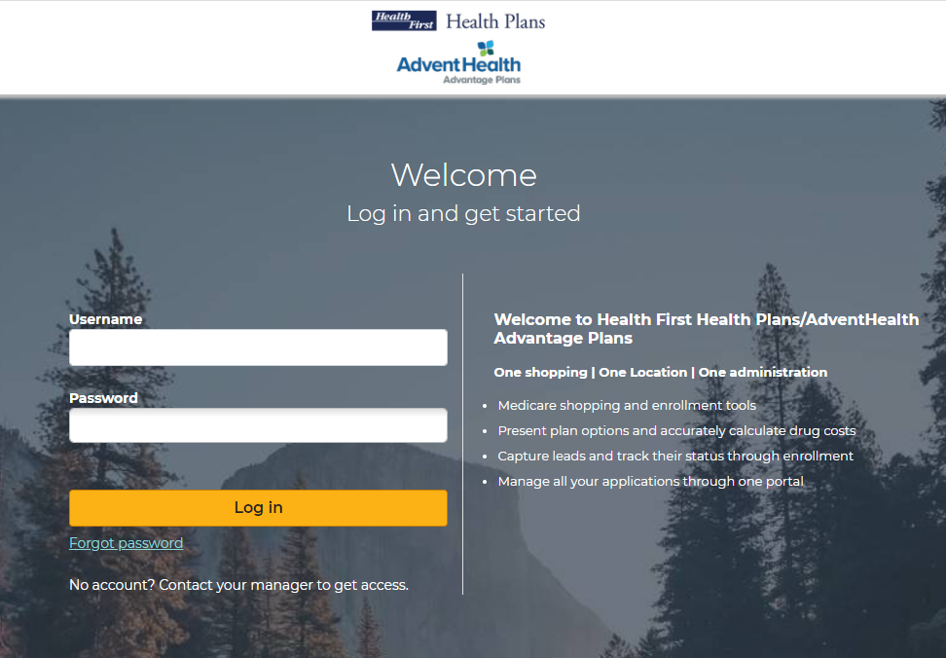
Medicare Enrollment Portal Login
Access the 2022 Medicare Enrollment Portal
Note: Save the URL in your browser “bookmarks” for easy, future access.

Slide 6
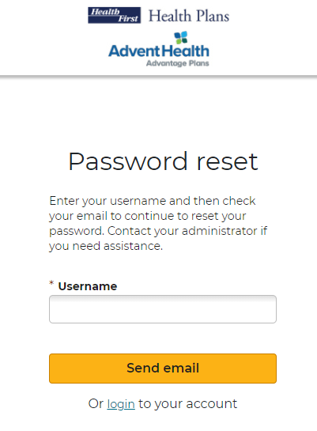
Initial Login, Reset, Forgot Password
As a broker, the first time you log in, you will need to use the Forgot Password link. This link is also used if you forget your password or wish to reset it.
Click the Forgot Password link.
Enter your NPN in the *Username field.
Click Send email
Log into email & verify email

Slide 7
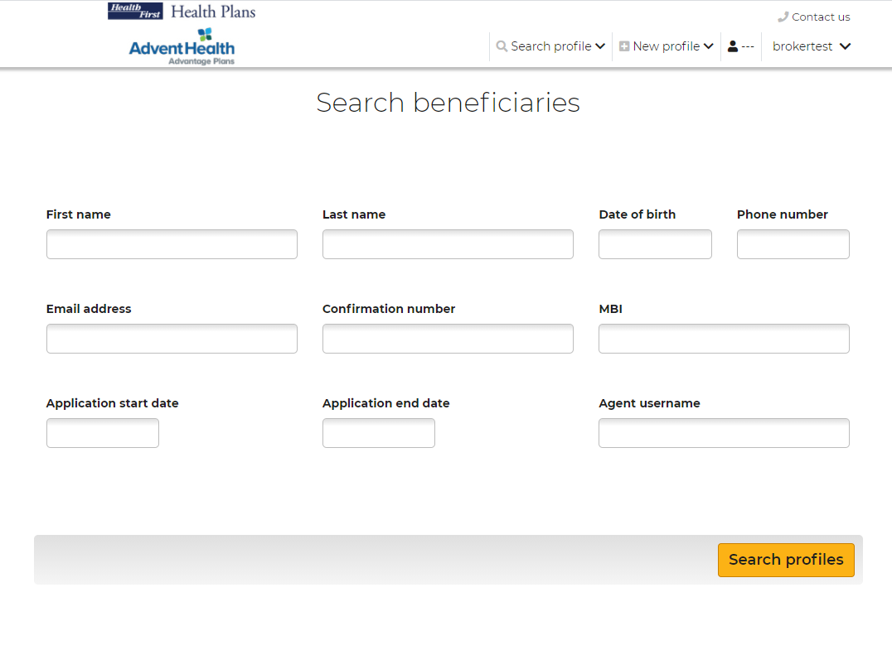
Search Beneficiaries
After logging in, the Search Beneficiary screen will display.
Use the top navigation bar to:
Search Profile
Create a New Profile
Access your Broker Profile

Slide 8
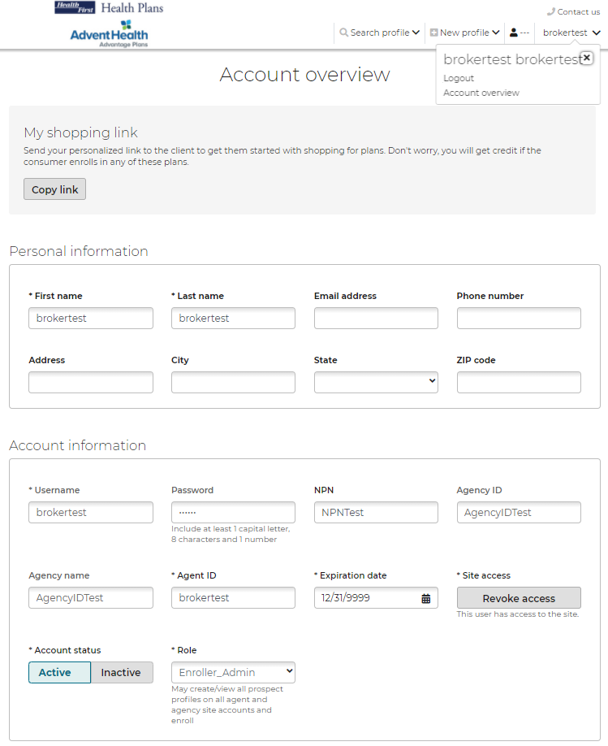
Top Navigation Broker Profile
View and edit your account information and/or logout of the portal.
Username: this field will always be your National Producer Number (NPN).
Account Overview: Broker demographic overview including username and password.
Logout of the portal
Notes:
Not sure if this is correct?

Slide 9
Top Navigation Search Profile
Search for an existing beneficiary profile in the system. If a beneficiary profile exists, clicking this option will enable you to access the beneficiary's saved information, including any enrollments in progress.
To search for a beneficiary:
Enter search parameters
Click Search profiles
Registrant status indicates a beneficiary who has not started an enrollment application.
Applicant status indicates a beneficiary who has either started or completed an enrollment application
If no search results are found, create a new profile and the search criteria that was entered will be automatically pre-filled into the New Profile.

Slide 10
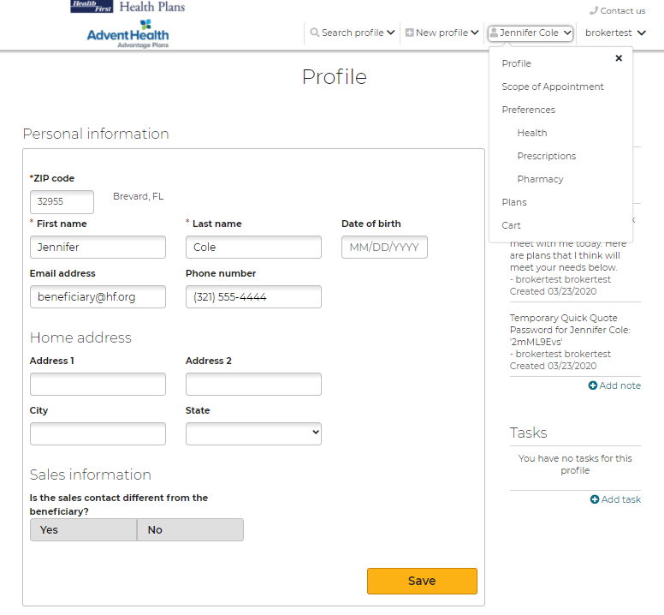
Top Navigation Beneficiary
After searching for an existing beneficiary profile in the system and selecting the client you would like to review, this beneficiary name will populate in the top navigation with a set of drop-down options to work from.

Slide 11
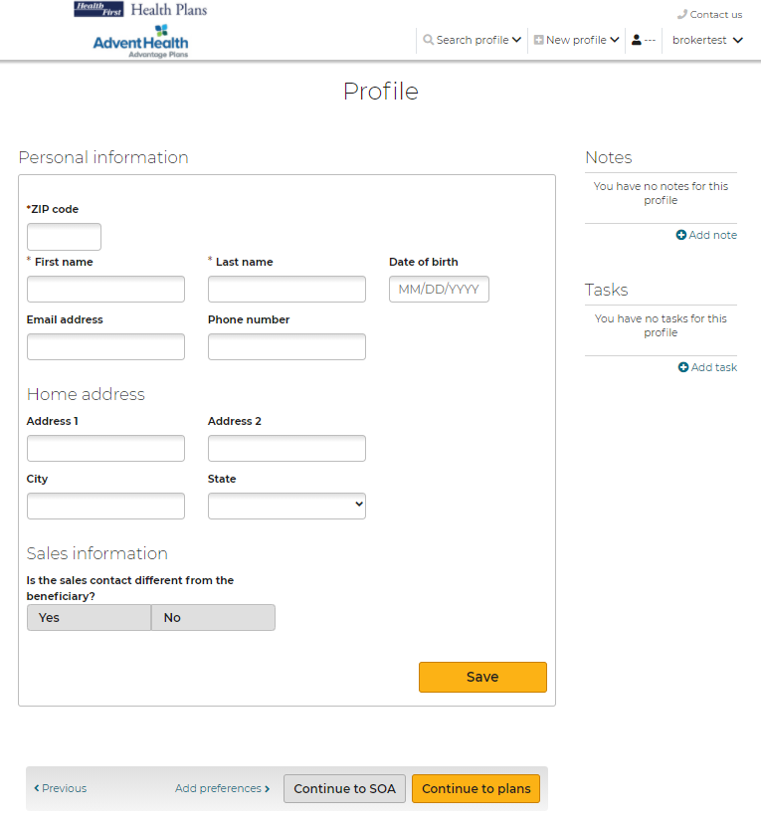
Top Navigation New Profile
If a beneficiary profile does not exist in the system, follow these steps:
To create a New Profile:
Click New Profile
Enter required information
Click Save
After a New Profile is created, you can:
Edit the beneficiary’s information
Shop for plans
Add preferences information
Send a Scope of Appointment
Send a Quick Quote
Start Enrollment

Slide 12
Profile Notes
Notes can be added to track:
Sending electronic SOAs
Enrollment applications sent via email or text
Some actions agents perform in the system generate notes automatically. For example, when agents send an electronic scope of appointment form, the email and date are added as a note.
Click Save after entering any Notes.

Slide 13
Profile Tasks
Tasks allow you to create reminders to perform actions to assist a beneficiary. These include:
Check SOA completion
Email materials or plan documents to beneficiary
Upload/view SOA’s from desktop
Document a scheduled meeting with the beneficiary
Click Save after entering any Tasks.
Click Continue to plans or Continue to SOA, below the profile form.

Slide 14
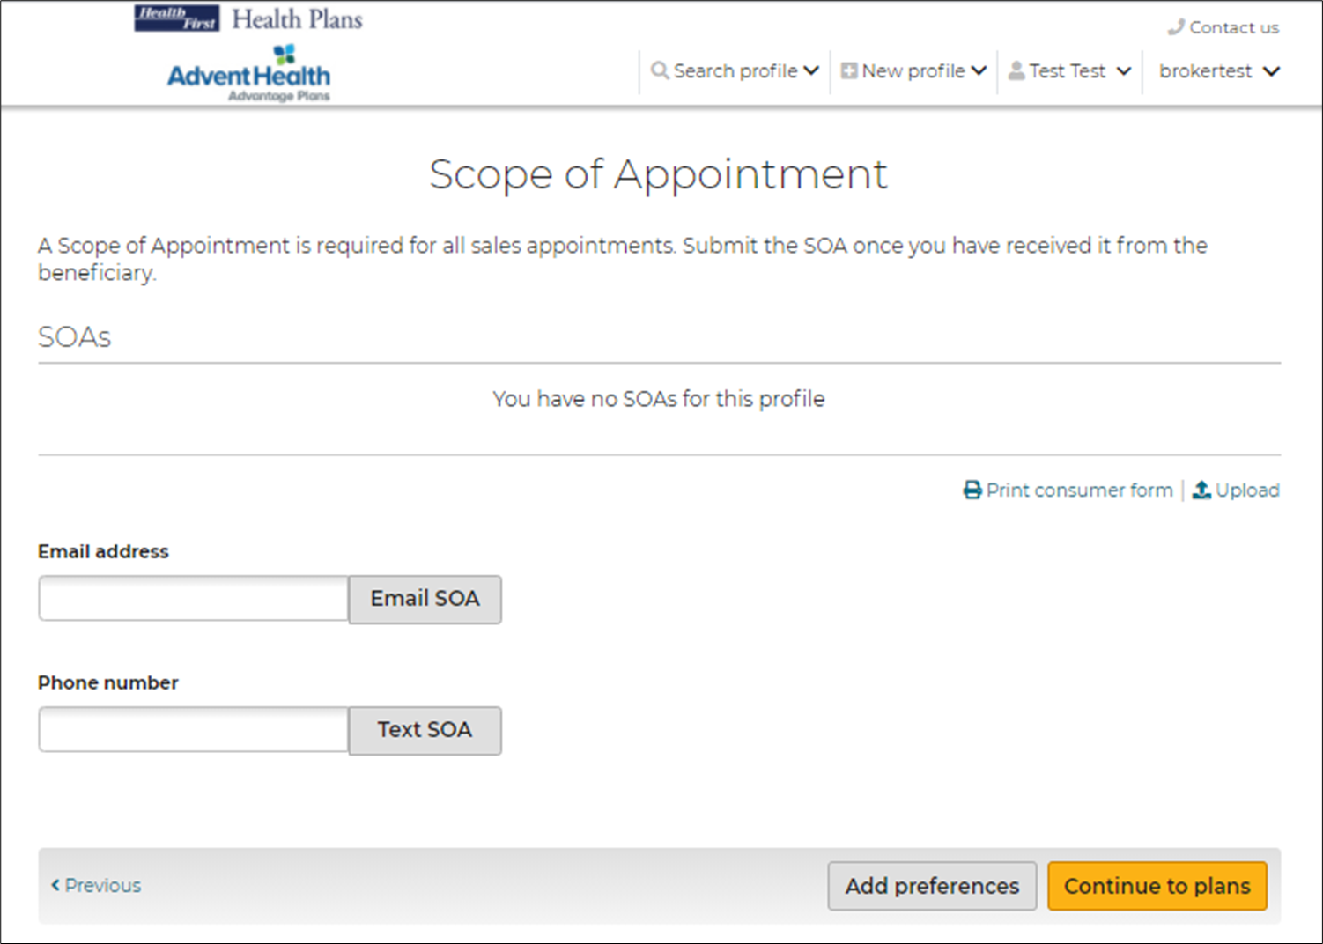
Scope of Appointment
View uploaded SOA’s
Upload new SOA’s received
Complete an SOA after the appointment
SOA’s sent via email or text will be documented in the Notes section

Slide 15
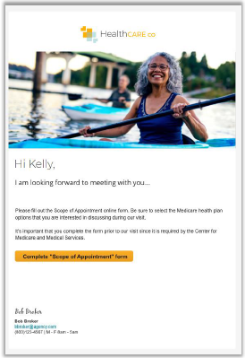
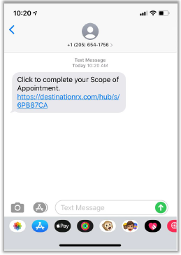
Scope of Appointments Sent to the Beneficiary
Sample Email
Sample Text

Slide 16
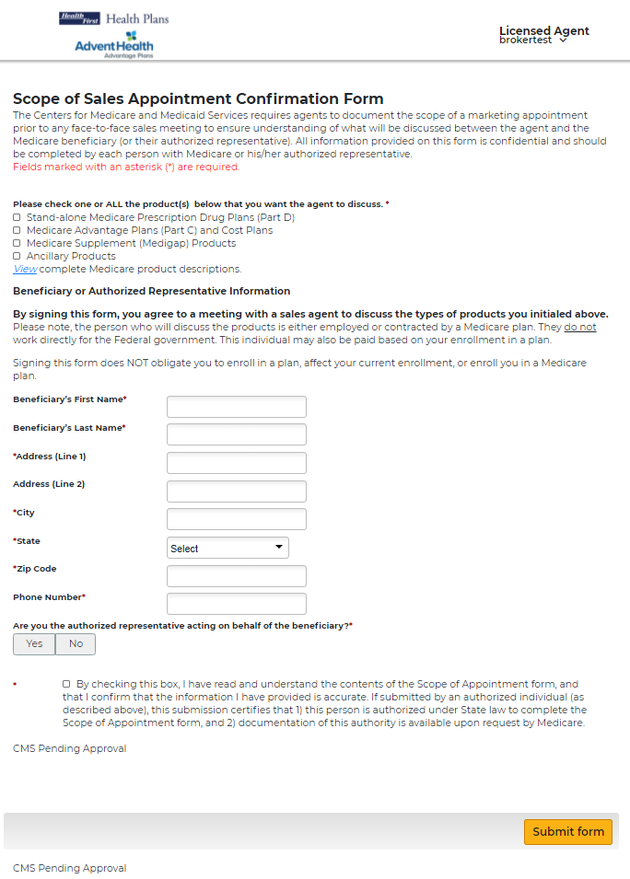
Scope of Appointment Received by the Beneficiary
This is a sample form the Beneficiary will see when the link in the email or text is selected.
Agent information will appear in upper right of the header.
The Beneficiary will choose options from the form to discuss at the appointment, complete all required fields, and submit the form.

Slide 17
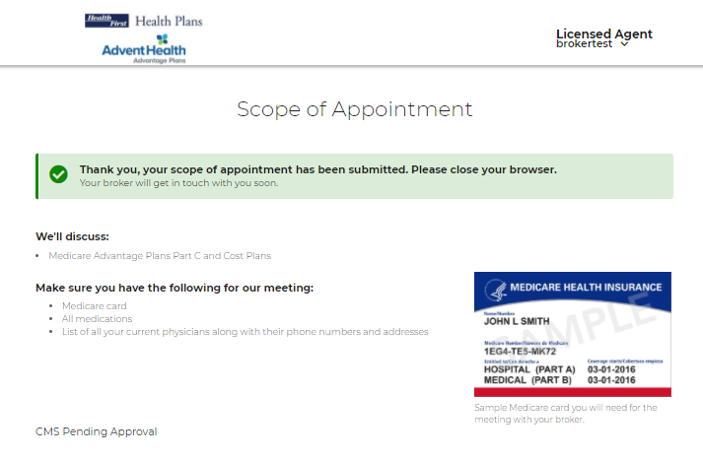
Scope of Appointment Completed by the Beneficiary
The Beneficiary will receive a confirmation message once they have successfully submitted their completed SOA.

Slide 18
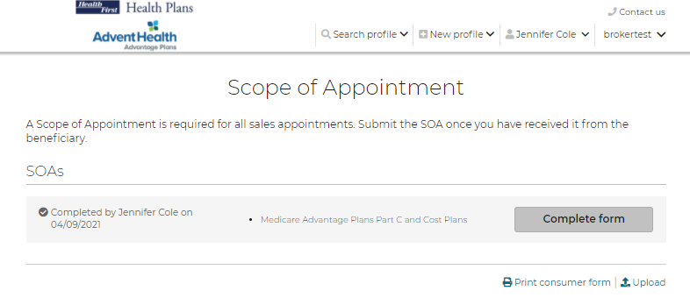
Agent Completion of the Scope of Appointment
The agent will receive a notification email (if the agent has an email on file) that the beneficiary has completed their portion of the form.
The agent will log into the system, search for that beneficiary, navigate to the SOA page, and click Complete form.

Slide 19
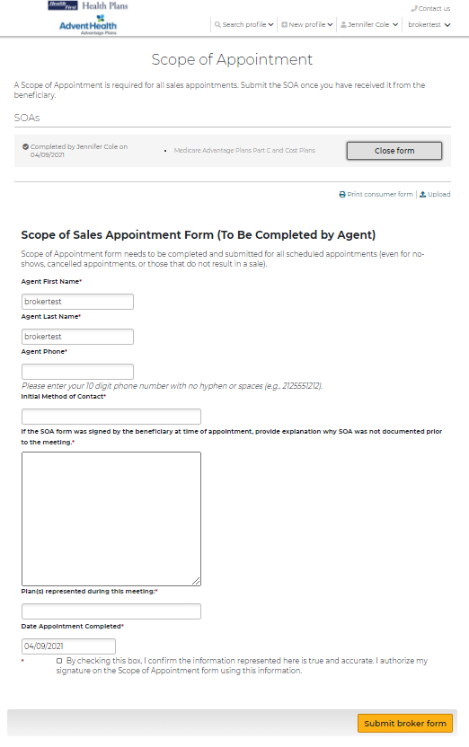
Agent Completion of the Scope of Appointment
This is a sample form the agent will see when they click to complete their portion after received back from the beneficiary.

Slide 20
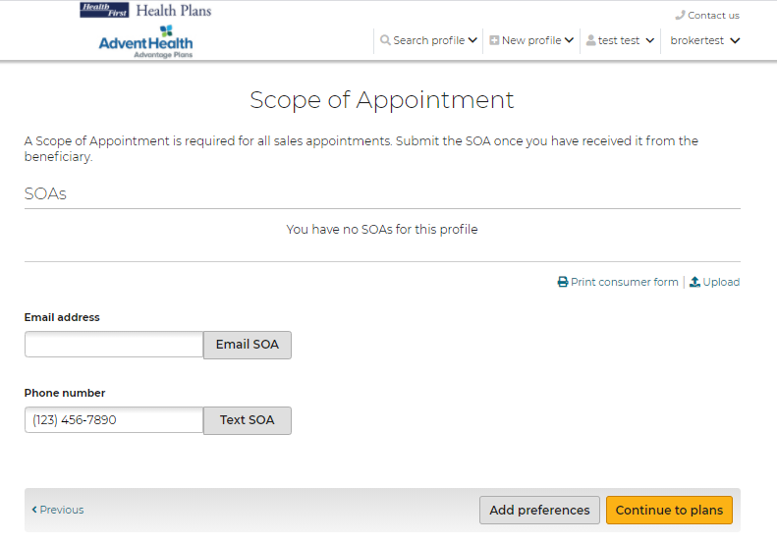
Uploading a Scope of Appointment
To upload an SOA that was completed outside of the system, click the Upload link on the SOA page and upload the document.

Slide 21
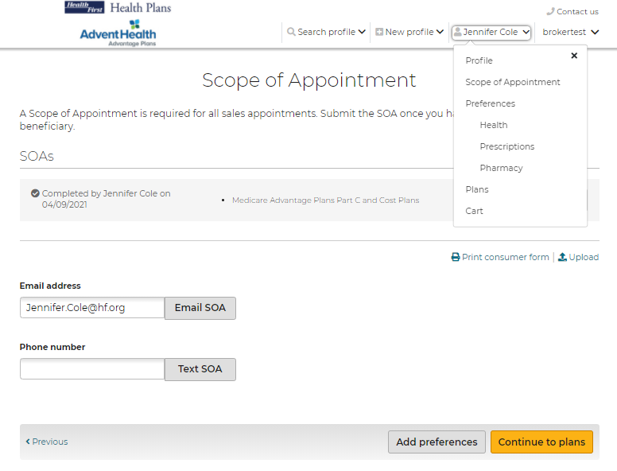
Getting Started
After the SOA is complete - get started with adding preferences, reviewing plans, and starting enrollment.
From the Beneficiary’s tab, click Preferences
Or click the Add preferences button from the bottom of the SOA page.

Slide 22
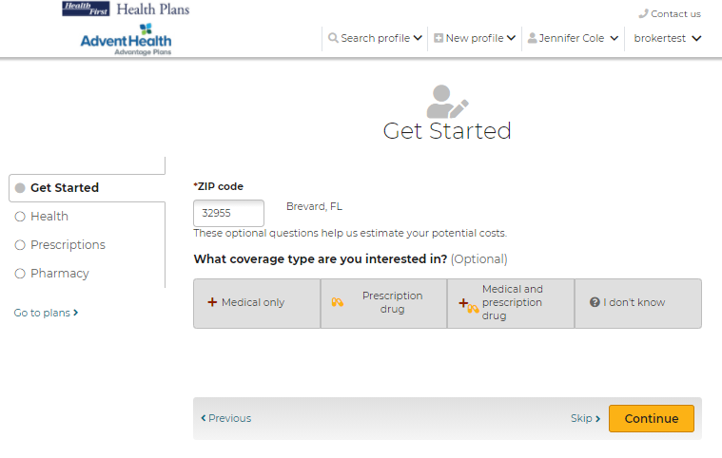
Getting Started
On the Get Started page, agents can provide the beneficiary’s zip code, select the interested coverage type and the Low-Income subsidy amount.
Providing the beneficiary's subsidy information allows the system to adjust premiums, prescription deductible and prescription copays in the plan cost estimates.
While working with a beneficiary profile, agents can access this page by selecting Preferences from the drop-down option.

Slide 23
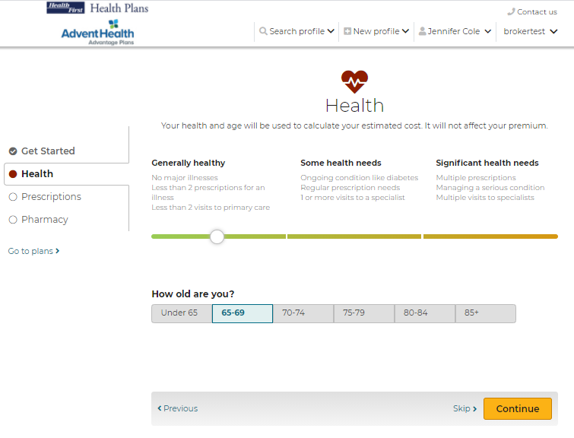
Getting Started - Health
Entering information about the beneficiary's location, age range, and health provides a list of available plans and calculates estimated out-of-pocket medical expenses.
While working with a beneficiary profile, agents can access this page by selecting Health from the drop-down option.

Slide 24
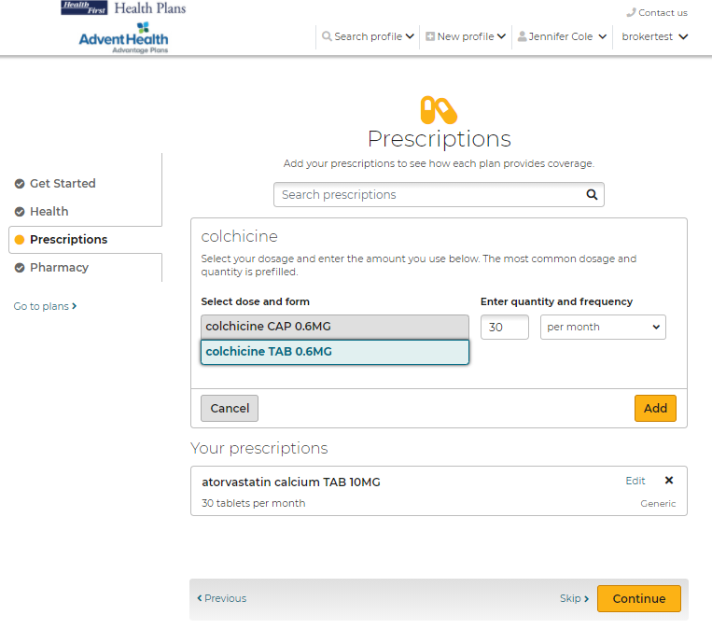
Getting Started - Prescriptions
It is recommended the beneficiary provide prescription drug information, as this allows agents and the beneficiary to understand if and how their drugs are covered and to provide a better out-of-pocket cost estimate.
Note: This step can be skipped by clicking Skip or Continue at the bottom of the page
While working with a beneficiary profile, agents can access this page by selecting Prescriptions from the drop-down option.

Slide 25
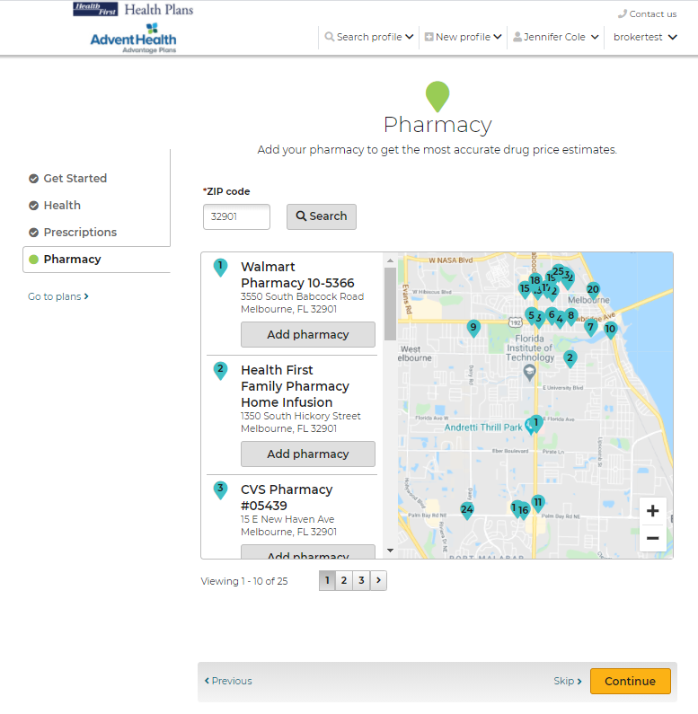
Getting Started - Pharmacy
The Pharmacy page allows agents to enter the place where the beneficiary fills prescriptions. This allows the system to provide more accurate prescription pricing.
Note: This step can be skipped by clicking Skip or Continue at the bottom of the page
While working with a beneficiary profile, agents can access this page by selecting Pharmacy from the drop-down option.

Slide 26
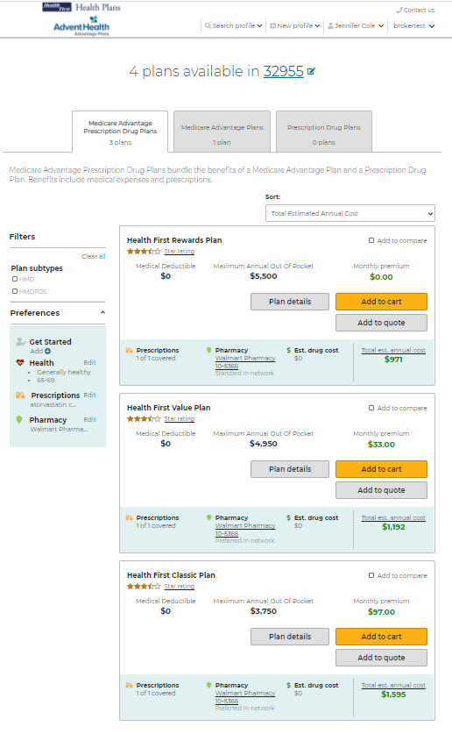
Plans
The Plans page allows agents to view all the plans that are available in the beneficiary’s service area.
The available plans, plan pricing, and estimated costs are impacted by several factors including the beneficiary's location, subsidy eligibility, prescription drugs, and pharmacy selected.
Plan cost estimates are more accurate with more information entered for the beneficiary.

Slide 27
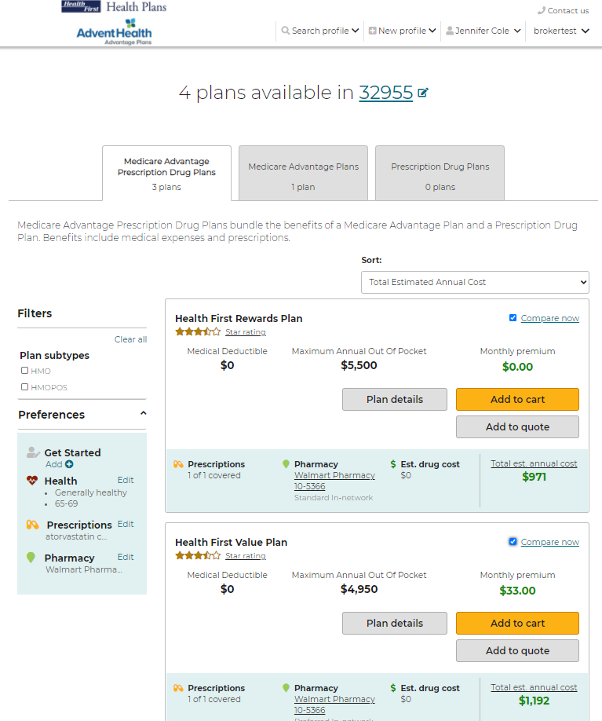
Compare Plans
Agents can compare up to 3 plans side by side on the Compare Plans page.
Check the boxes of the plans you’d like to compare, then click, Compare now.

Slide 28
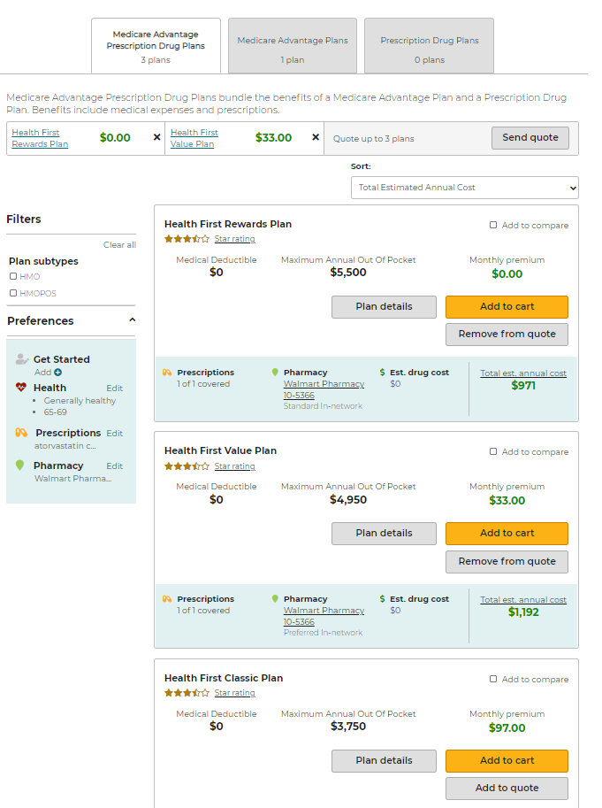
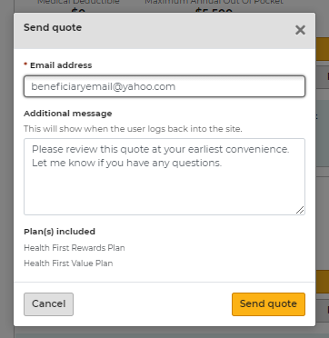
Send a Quote to the Beneficiary
Agents can add specific plans to a quote and email to their beneficiary by clicking Add to quote.
The selected plans will list at the top. When you are ready to email to your beneficiary click, Send quote.
A message window will display asking for the beneficiary’s email and message to accompany the quote. Click Send quote when finished.

Slide 29
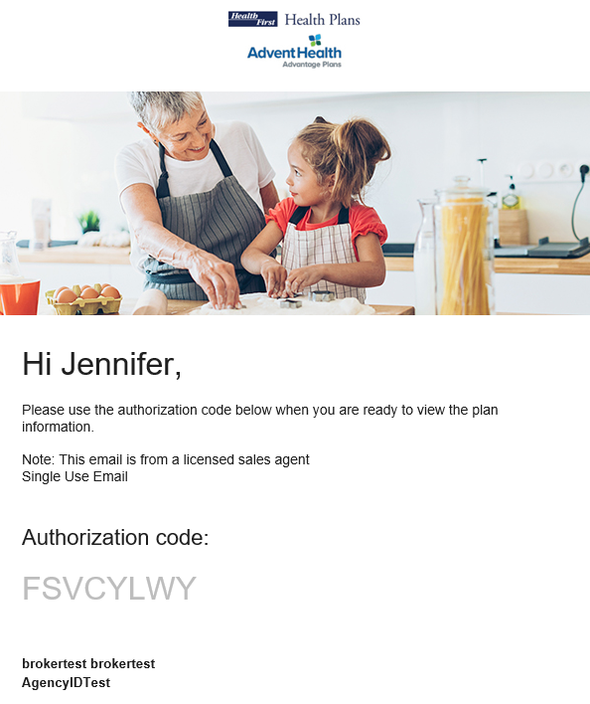
Send a Quote to the Beneficiary
When a quote is sent successfully, the beneficiary receives two emails that can be used to access the quote:
One with the link to view the quote
One with the access code
These are separate for security reasons because protected health information (PHI) is involved.

Slide 30
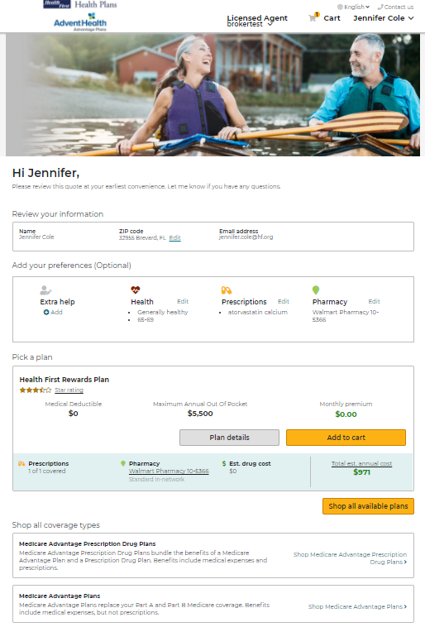
Quote Authorization and Summary
Upon successful authentication, the beneficiary lands on the quote summary page.
The beneficiary, will have access to Add to cart and continue to the enrollment process if they choose.
The links provided in the email contain the Agent ID, which ensures agents get credit for any enrollments that result from the Quote.

Slide 31
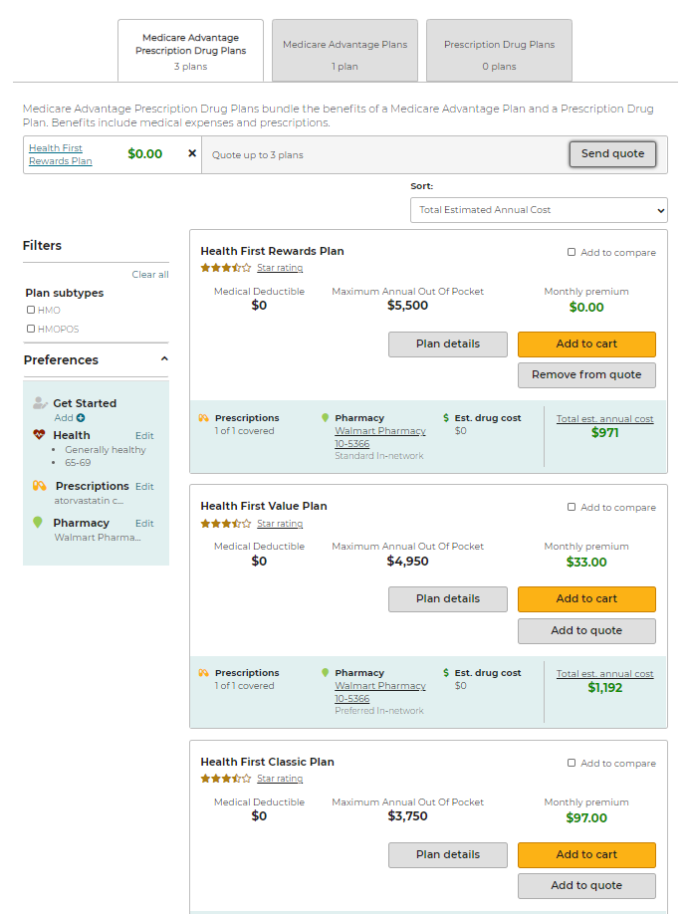
Start Enrollment Add to Cart
Once the beneficiary has made their plan selection, the agent can begin the enrollment process.
First, click Add to cart next to the plan option the beneficiary has selected.

Slide 32
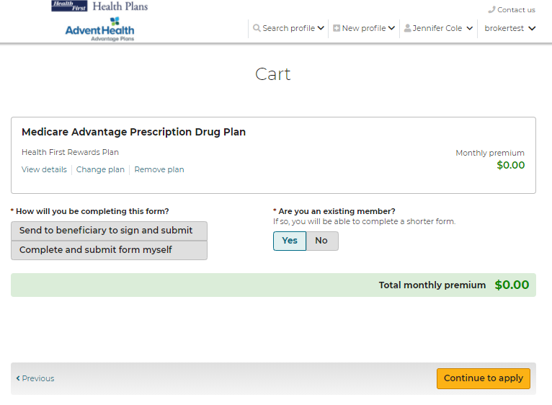
Start Enrollment Add to Cart
Two options are offered:
Enrollment can be completed through sending to the beneficiary to sign and submit
Agent can complete and submit the enrollment on behalf of their beneficiary ONLY if the agent is sitting with their beneficiary to complete this enrollment.
Also, be sure to note if this beneficiary is an existing member. If yes, it will result in completion of a shorter enrollment form.
Click, Continue to apply to move ahead with the application.

Slide 33
Enroll a Beneficiary
Agents that select the option: Complete and submit form myself
The electronic enrollment form will guide agents through a 5-step process of submitting the enrollment application.
Fields marked with an asterisk are required and agents will not be able to proceed until marked.
Beneficiaries will need to be present with their agent in order to sign the application at step 5.
To complete the enrollment, agents will click Submit at the bottom of step 5.

Slide 34
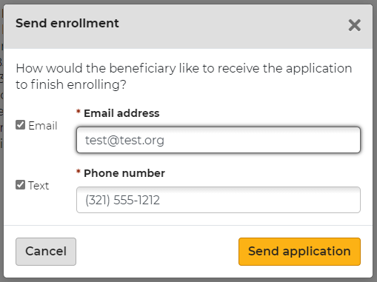
Enroll a Beneficiary
Agents that select the option: Send to beneficiary to sign and submit
The electronic enrollment form will guide agents through a 4-step process.
Fields marked with an asterisk are required and agents will not be able to proceed until marked.
Agents will complete their portion of the enrollment and click Send to beneficiary at the bottom of step 4.
An email or text will be sent to the beneficiary
to review, sign, and submit the completed
enrollment application. Note: The beneficiary will
either receive two texts or two emails, one with
the link and one with the authorization code.

Slide 35
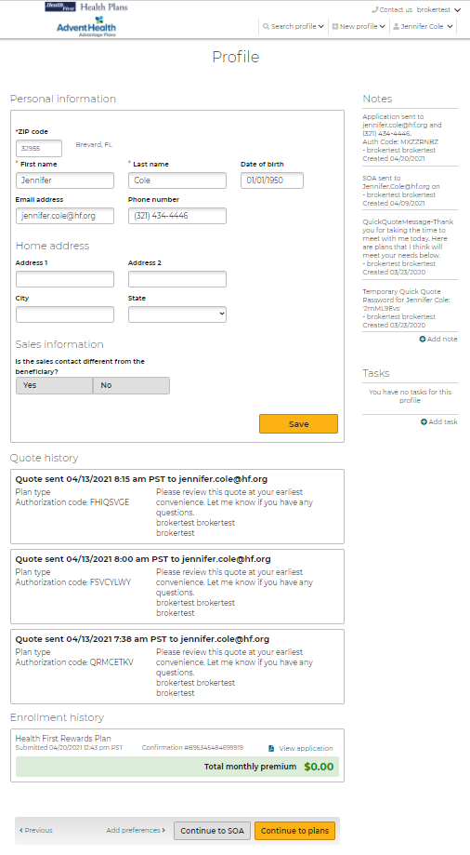
Enrollment History
There will be no email notification to the agent.
Agents will need to log back into the Medicare Enrollment Portal and check the beneficiary's profile for enrollment completion.
The Profile page allows agents to view a beneficiary’s enrollment history.
Agents can access this page by:
searching for a profile
opening the profile
then scrolling down to the Enrollment history section

Slide 36
Enrollment History
Three types of enrollment status information may display under the Enrollment history section:
Current year in-process enrollments at the top of the list. These are applications that have been started but not completed for the current plan year and will offer a link to Continue enrollment.
Current year completed enrollments are listed below the in-process enrollments. These are completed enrollment applications for the current plan year and may include information about riders, documents uploaded during enrollment, and the ability to view the PDF of the application.
Past enrollment information is at the bottom. This may include plan name and other information.

Slide 37
Helpful Contacts
Broker Services
321.434.5265
HFBroker@HF.org
Commissions
Commissions@HF.org
For plan year 2021 and prior questions
HF-brokercommissions@plusoscar.com
For plan year 2022 and beyond questions
Customer Service
Broker Support
Local: 321.434.4945
Toll Free: 877.693.6489
HFHPInfo@HF.org
HF-brokers@plusoscar.com

Slide 38
Thank You!

